Slide 1
Mission Beyond Update
Highlighting the Work of One of Our Mission Partners

Slide 2
ST. MARY’S MISSION STATEMENT
To reach out to the lost and see them established as disciples
To show God’s love in practical action as part of a Christ-centred gospel ministry

Slide 3
MISSION AVIATION FELLOWSHIP

Slide 5
M.A.F. are a lifeline to isolated communities…
Imagine if your community had no roads or little access to the outside world
How would you or your family reach a doctor if you’re sick or injured?
How can you receive an education or job opportunities?
Jungles, mountains, swamps, insecurity and dilapidated infrastructure are all barriers to receiving physical and spiritual care and a hope for the future

Slide 6
That’s Why They Fly
M.A.F are a Christian mission organisation that uses planes to overcome these barriers. Pilots and personnel deliver relief workers, doctors, pastors, school books, food, medicines - everything that can only be safely and speedily delivered by air.
With an MAF plane taking off or landing every three minutes, the need is huge.

Slide 7
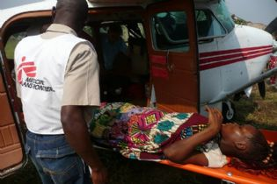
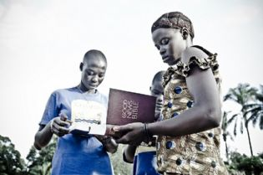
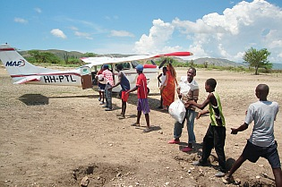
M.A.F flies planes to help with:
Medical Emergencies
Missionary Visits
Disaster Relief

Slide 8
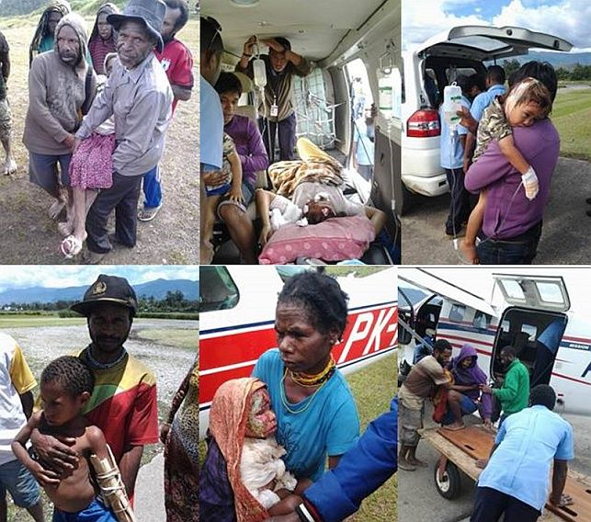
And transforms communities…

Slide 9
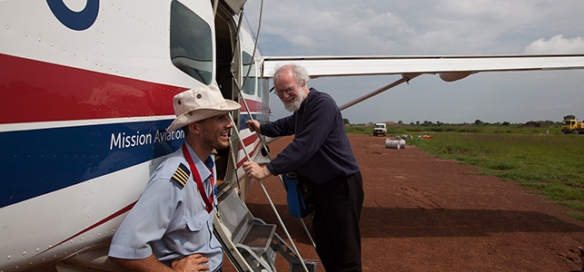
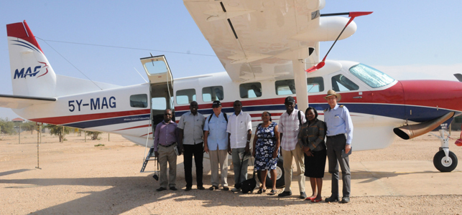
Latest News…
South Sudan
Kenya
Bangladesh
Dr. Rowan Williams travelled with MAF to South Sudan to promote peace.
Churches planted in Turkana, Northern Kenya, are flourishing…
Transforming the lives of Under 5’s in Barguna District suffering from malnutririon

Slide 10
THANK YOU ST. MARY’S
THROUGH MISSION BEYOND, YOUR DONATIONS GO TOWARDS THIS VITAL WORK.
YOU ARE HELPING ISOLATED COMMUNITIES ALL OVER THE WORLD.
YOUR PRAYERS, LOVE AND SUPPORT MAKE A DIFFERENCE TO SO MANY LIVES.

Slide 11
PRAYER POINTS
M.A.F ALWAYS NEED ENGINEERS, PILOTS AND GROUND STAFF – PRAY THAT THESE JOBS ARE FILLED
THE EBOLA CRISIS IS STRETCHING RESOURCES, PRAY THAT M.A.F CAN BE EFFECTIVE IN BEING PART OF THE CONTAINMENT OF THIS HORRIBLE VIRUS
FOR GOD TO CONTINUE TO BLESS THE WORK OF M.A.F AND SUPPLY ALL THEIR NEEDS

Slide 12
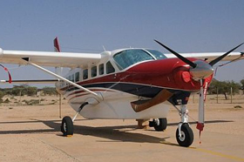
Want to know more…
Check out:
maf-uk.org
Ask any of the Mission Beyond team for information on how you can help
Sign up for prayer letter/email/updates

