Slide 1
MISSION BEYOND UPDATE
HIGHLIGHTING THE WORK OF ONE OF OUR MISSION PARTNERS

Slide 2
MISSION BEYOND STATEMENT
To reach out to the lost and see them established as disciples
To show God’s love in practical action as part of a Christ-centred gospel ministry

Slide 3
CPAS (Church Pastoral Aid Society)

Slide 4
Making disciples, developing leaders, growing churches…
CPAS IS AN ANGLICAN MISSION AGENCY WORKING WITH CHURCHES, MAINLY IN THE UK AND REPUBLIC OF IRELAND
THEIR MISSION IS TO ENABLE CHURCHES TO HELP EVERY PERSON HEAR AND DICOVER THE GOOD NEWS OF JESUS CHRIST

Slide 5
THE CPAS PROGRAMME INCLUDES:
Enabling hundreds of churches to make disciples and develop leaders through our Growing Leaders and Mentoring Matters courses.
Helping churches continue to thrive in times of vacancy through our Growing Through a Vacancy resource.
Equipping influential younger leaders on our Arrow Leadership Programme.
Partnering with dioceses to deliver high-quality bespoke training for clergy and lay leaders.
Resourcing thousands of leaders be more effective through Lead On.
Giving 4,500 children and young people an amazing week of fun, faith and friendship on our Ventures and Falcon Camps each year.
Appointing evangelical clergy to our 500+ patronage churches

Slide 6
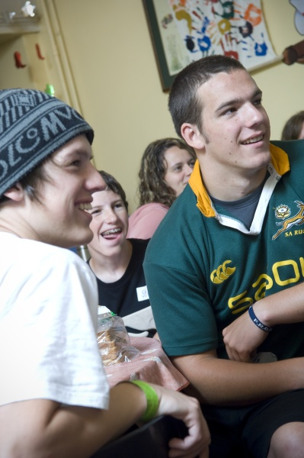
VENTURE HOLIDAYS… LIFE CHANGING HOLIDAYS FOR AGES 8-18

Slide 7
GROWING CHURCHES
'It's been an amazing couple of years. We had a vision of making more outreach happen, so we needed to equip people to make this a reality. Thanks to Growing Leaders we've started new activities including a youth club, which attracts 25 young people every fortnight.' Jo
'Arrow has been a truly ministry-saving experience. The combination of a loving community, excellent Bible teaching and great wisdom from experienced leaders enabled me to find a fresh intimacy with God and learn skills and habits that have transformed my ministry.' - Henry

Slide 8
THANK YOU ST. MARY’S…
YOUR DONATIONS, GIVEN THROUGH MISSION BEYOND HELP TO FUND THIS WORK
YOU ARE HELPING TO GROW CHURCHES ALL ACROSS THE UK.
THANK YOU SO MUCH FOR YOUR SUPPORT.
CHECK OUT CPAS.ORG FOR MORE INFORMATION OR ASK ONE OF THE MISSION BEYOND TEAM TO SEE HOW YOU CAN GET INVOLVED.

Slide 9
To enable you to pray FOR CPAS, THEY produce a quarterly Prayer Diary, with daily prayer points about THEIR work with churches and church leaders in the UK and the Republic of Ireland. During the summer you can also download the Ventures and Falcon Camps prayer poster, or request a copy by contacting ventures@cpas.org.uk.
FOR THE WORK OF CPAS

