Slide 1
MISSION BEYOND UPDATE
HIGHLIGHTING THE WORK OF ONE OF OUR MISSION PARTNERS

Slide 2
St. Mary’s Mission statement
To reach out to the lost and see them established as disciples
To show God’s love in practical action as part of a Christ-centred gospel ministry

Slide 3

CHRISTIAN HOPE INTERNATIONAL

Slide 4
HELPING TO BRING HOPE…
C.H.I seeks to provide aid to the needy in Africa and Eastern Europe. The charity not only provides material needs, but aims to share the Christian message of love and Hope in Jesus. There are three different aspects to the work of the Charity…

Slide 5
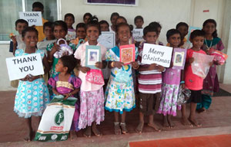
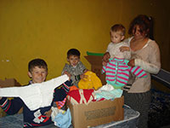
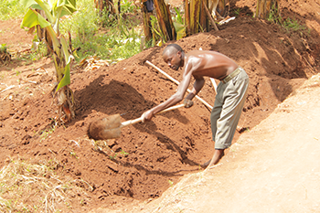
Bringing hope
Ray of Hope
Stitches of Hope
Small Project Finance
Child sponsorship where financial support is given to enable a child to receive a good education
Hand knitted clothes and blankets are donated and sent to Eastern Europe
Low cost initiatives to support small community and family projects such as providing mosquito nets, egg laying hens, tools and clean water

Slide 6
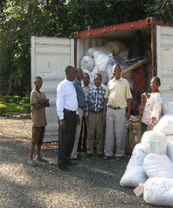
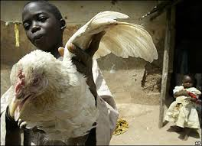
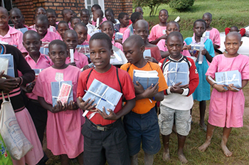
Latest news
20/20 HARVEST CHALLENGE
CONTAINER AID
SCHOOL SUPPLIES
C.H.I are 20 years old and have launched a challenge to raise £2020 to buy livestock for those in need. These are given to orphans in Africa to improve their diet and nutrition.
STOP PRESS: Due to the cancellation of tax exemptions on containers by the authorities in Africa, the decision has been made to stop this work.
Funds were recently sent to Pastor Patrick Ssimbwa, who purchased a basic pack for each of the children in most need. It costs just £5 to provide an education pack for a child

Slide 7
THANK YOU ST. MARY’S….
YOUR MONEY, GIVEN THROUGH MISSION BEYOND, HELPS THIS AMAZING LITTLE CHARITY PERFORM ITS MIRACLES EVERY DAY.
EVERY PENNY HELPS AND MAKES SUCH A DIFFERENCE….

Slide 8
WHAT TO PRAY FOR:
THANK GOD FOR ALL THE VOLUNTEER KNITTERS WHO FAITHFULLY KNIT FOR FAMILIES IN EASTERN EUROPE
FOR GOOD RELATIONSHIPS WITH CHURCHES AND ORGANISATIONS IN THE COMMUNITIES C.H.I. WORK IN
FOR GOD TO HONOUR AND GLORIFY THE WORK C.H.I. DOES IN AFRICA AND EASTERN EUROPE
PRAY FOR THE TARGET OF £2020 TO BE REACHED THIS YEAR.

Slide 9
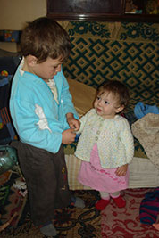
HOW YOU CAN HELP…
PRAY FOR C.H.I.
COLLECT WOOL AND/OR KNIT GARMENTS
CHECK OUT THE WORK OF C.H.I. AT christianhope.org.uk
SPEAK TO ANY OF THE MISSION BEYOND TEAM – COME AND JOIN US!

