Slide 1
MISSION BEYOND UPDATE
HIGHLIGHTING THE WORK OF ONE OF OUR MISSION PARTNERS

Slide 2
ST. MARY’S MISSION STATEMENT
To reach out to the lost and see them established as disciples
To show God’s love in practical action as part of a Christ-centred gospel ministry

Slide 3
THE LEPROSY MISSION

Slide 4
THE LEPROSY MISSION ARE:
an international Christian development organisation that diagnoses, treats and offers specialist care, including reconstructive surgery, to leprosy patients. Their aim is to transform and empower the lives of people affected by leprosy.

Slide 5
STIGMA
Widely believed to be the world's oldest disease, leprosy is also one of the world's most stigmatised. A specialist approach is required to educate, encourage and empower people to stand up for their human rights. Age-old stigma surrounding leprosy sees entire families robbed of their job opportunities, education, marriage prospects and their dreams shattered.
2,253 people living in leprosy-affected communities in Niger accessed clean water supplies in 2013.
Thousands of leprosy-affected people in India are now claiming the state benefits they are entitled to as a result of our advocacy work.

Slide 6
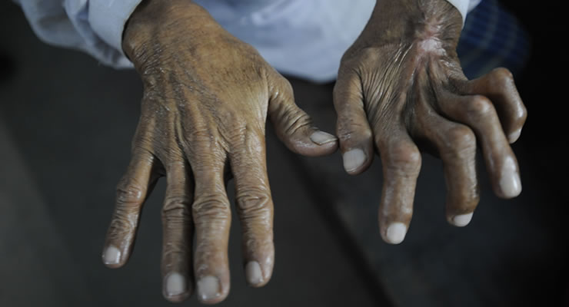
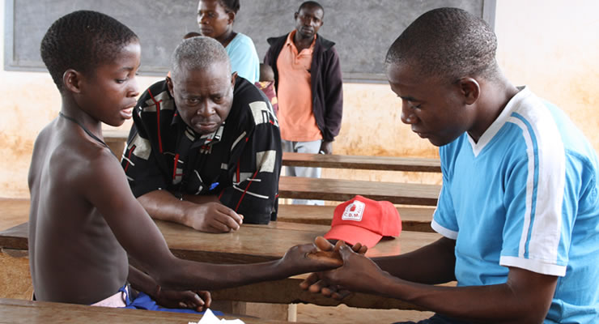
LEPROSY IS A DISEASE OF THE POOR. IT CAN BE CURED IF TREATED EARLY ENOUGH

Slide 7
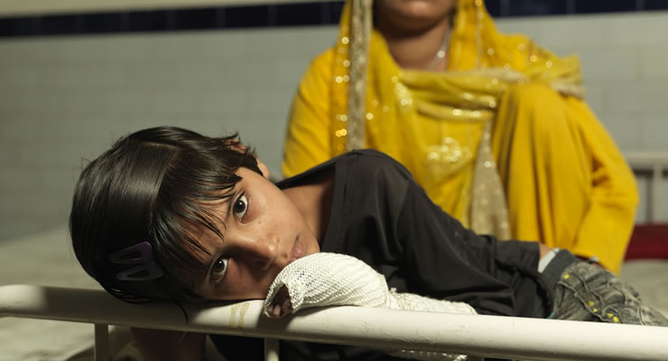
HOW LEPROSY MISSION HELPS…
THROUGH MEDICAL PROVISION, REHABILITATION AND DISABILITY CARE
HOUSING, WATER AND SANITATION
EDUCATION, TRAINING AND LIVELIHOODS
ADVOCACY

Slide 8
LATEST NEWS:
Good news from South Sudan…As the crisis in South Sudan continues, it's encouraging that our work there is making a real difference to the lives of people affected by leprosy.
Former politician, writer and broadcaster Ann Widdecombe has paid a visit to The Leprosy Mission England and Wales’s headquarters in Peterborough where she encouraged staff, volunteers and Board members that the work they are doing is essential in fighting leprosy and extreme poverty across Africa and Asia.
Ahead of the last General Election the three main political parties pledged to enshrine in law the UK's commitment to spending 0.7% of national income on international aid. Despite being written into the Coalition agreement in 2010, only in September 2014 is it set to become a reality after tireless campaigning by charities including The Leprosy Mission.

Slide 9
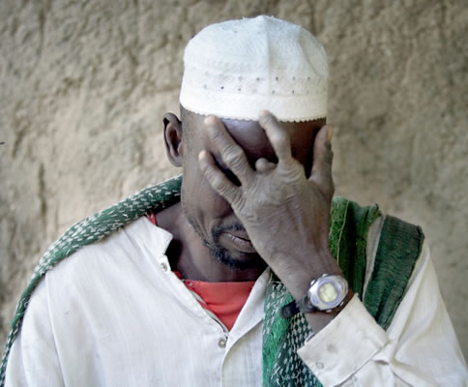
HOW YOU CAN HELP…
PRAY FOR THE WORK OF THE LEPROSY MISSION
HOST A COFFEE MORNING, CRAFT SALE OR OTHER FUNDRAISER TO HELP THE WORK OF LEPROSY MISSION
ON WORLD LEPROSY DAY – 25/1/15 – WE INVITE YOU TO HELP TRANSFORM THE LIVES OF SOME OF THE WORLD’S POOREST AND MARGINALISED PEOPLE.
THIS SPECIAL DAY RAISES AWARENESS OF LEPROSY AS A 21ST CENTURY DISEASE. THIS YEAR, PROCEEDS WILL SUPPORT THOSE AFFECTED BY LEPROSY IN ANANDABAN HOSPITAL IN NEPAL.

Slide 10
YOUR DONATIONS, GIVEN THROUGH MISSION BEYOND, ARE HELPING THE AMAZING WORK OF THE LEPROSY MISSION…
THANK YOU ST. MARY’S….

